Slide 1
WRITING
WRITABLE APIS
THE
WRITE
WAY
ROB
@dN0t

Slide 2
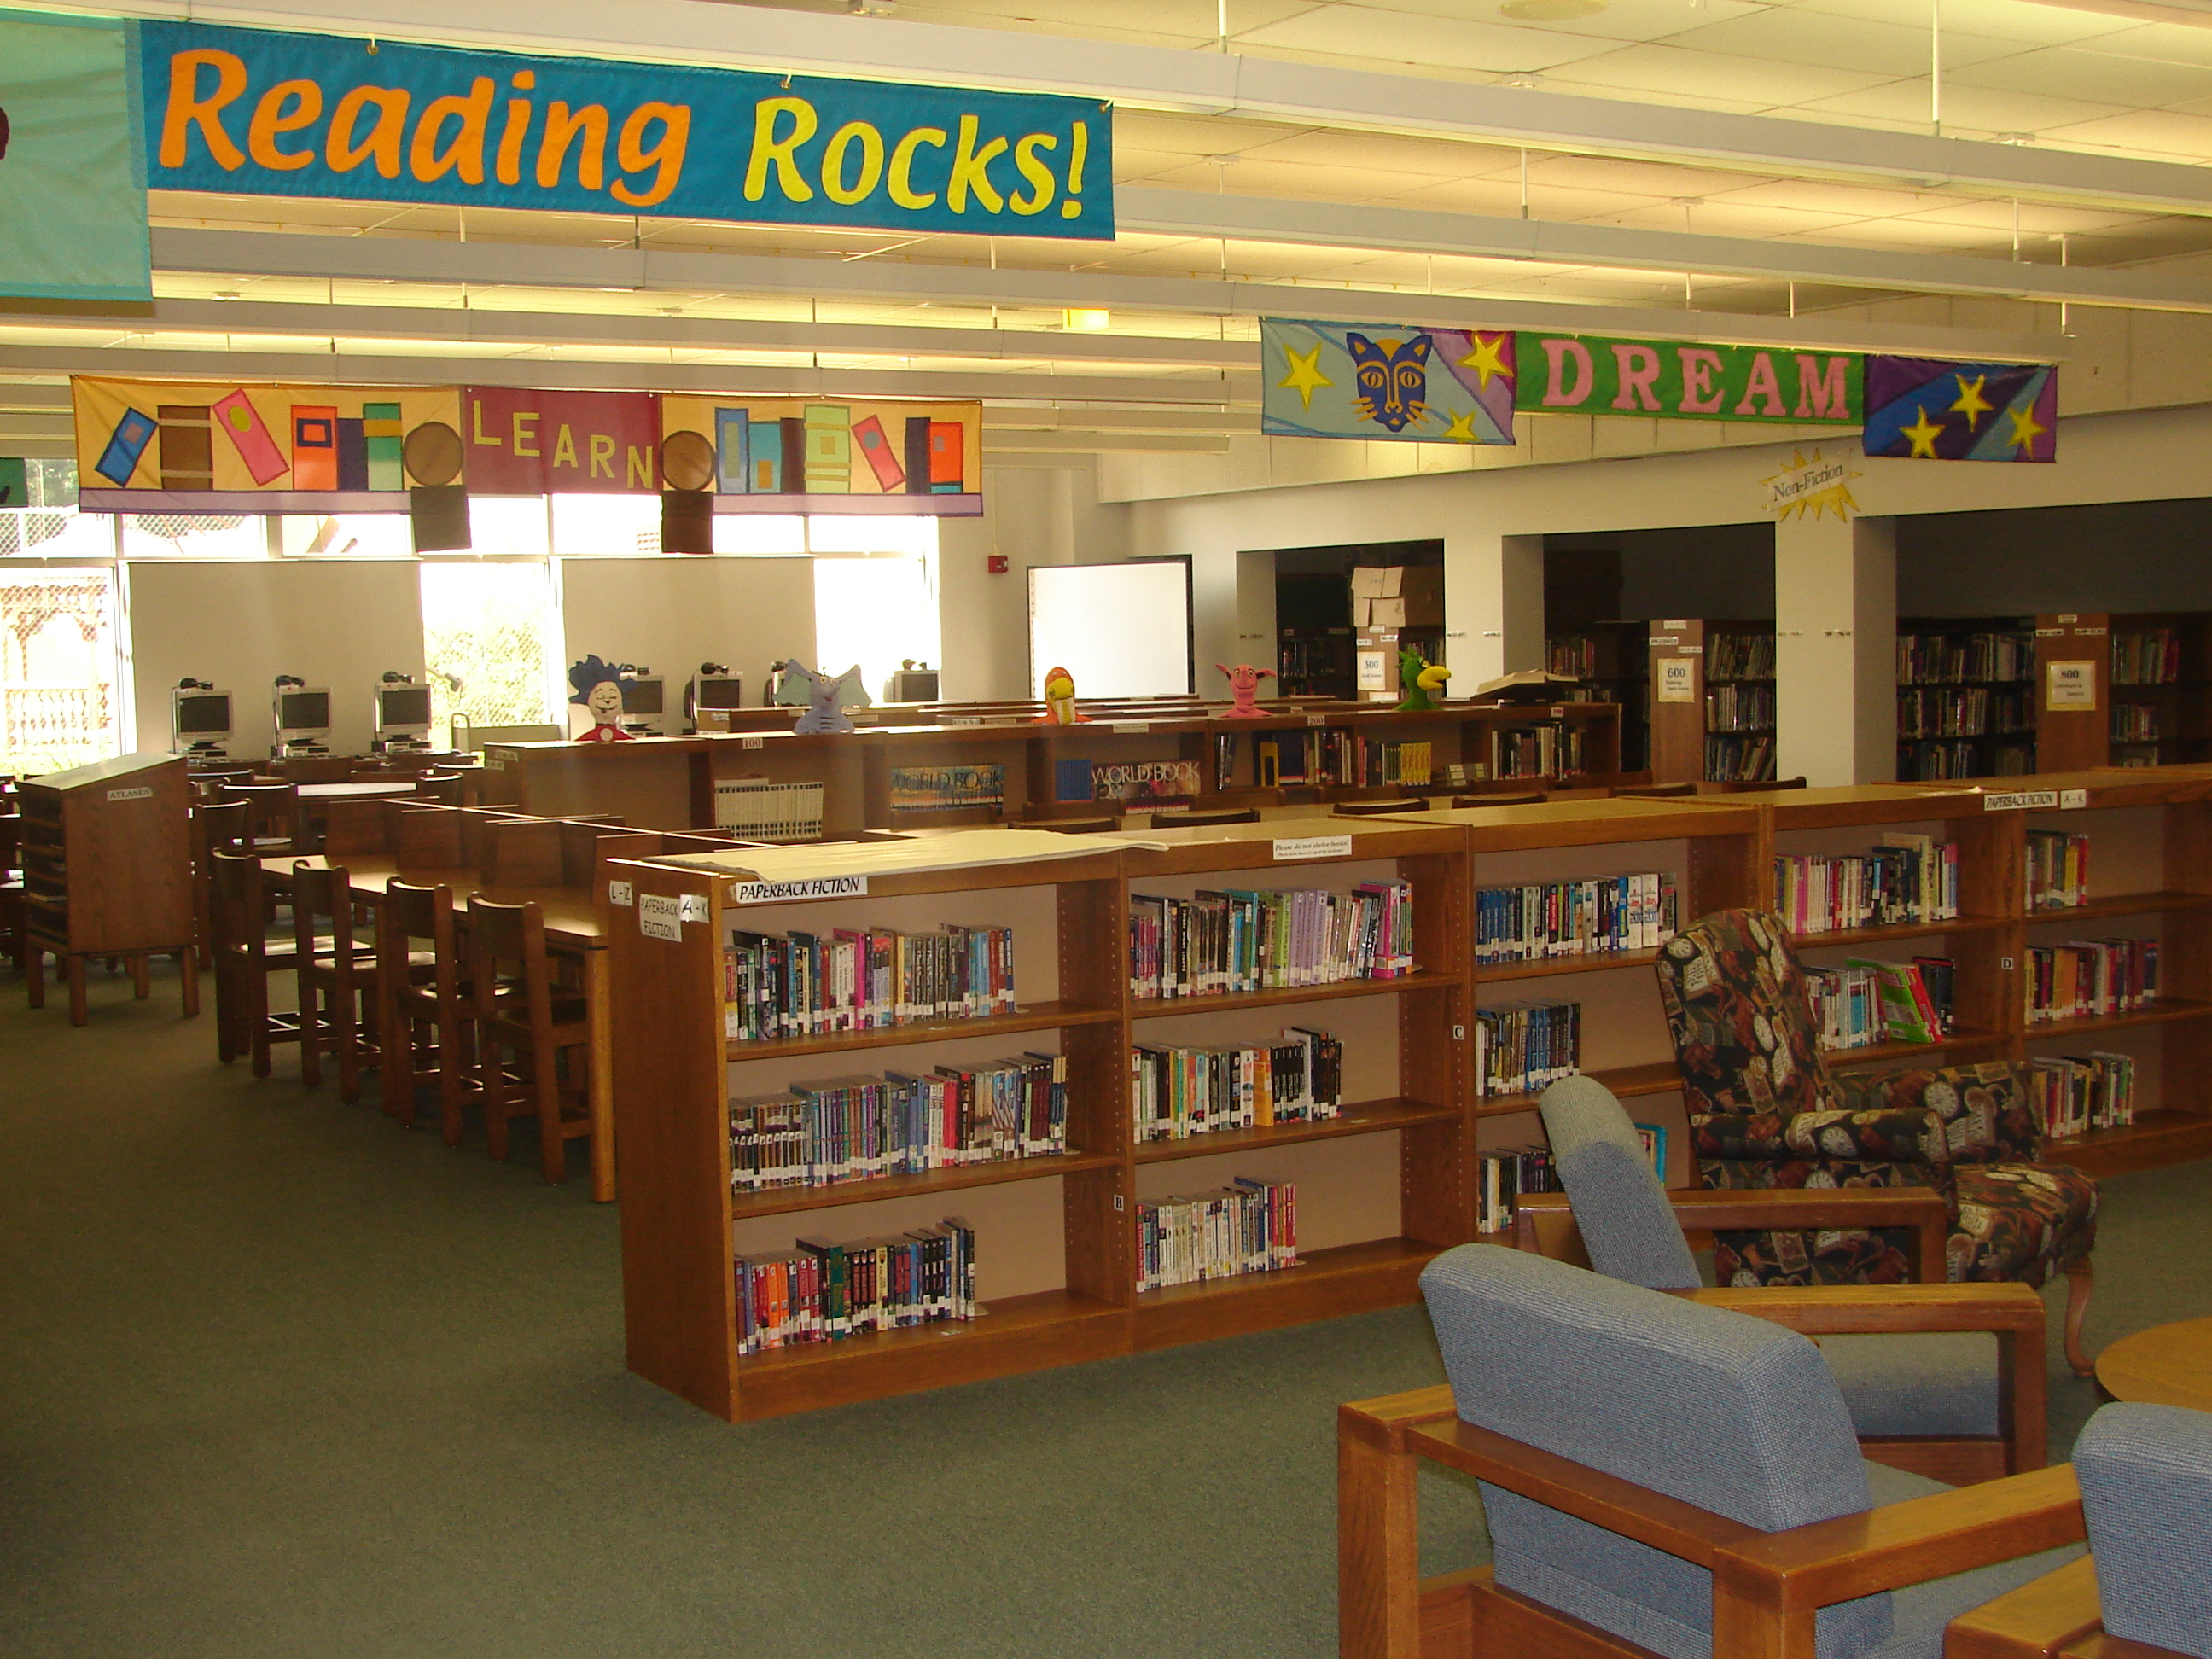
THE INTERNET
IS TOTALLY FULL OF BOOKS

Slide 3
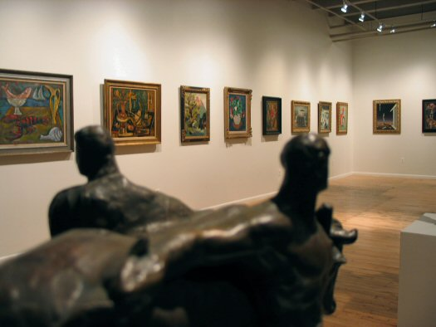
THE INTERNET
IS (NOT REALLY) A LIBRARY

Slide 4
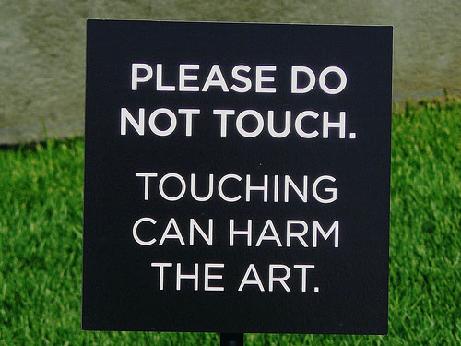
THIS JOINT
IS FOR SQUARES

Slide 5
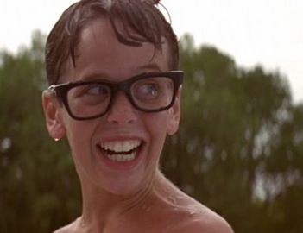
READ APPS AREN'T COOL
YOU KNOW WHAT'S COOL?

Slide 6

JUSTIN TIMBERLAKE
IS COOL.

Slide 7
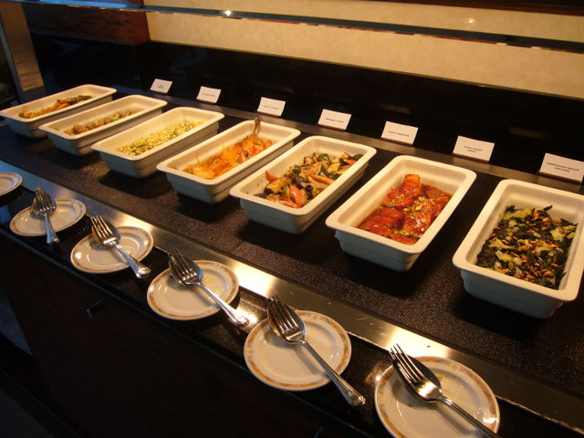
THE DATA BUFFET
IS BIGGER THAN SIZZLER

Slide 8
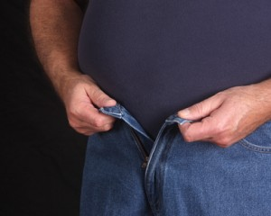
OAUTH IS KINDA
HARD TO GET INTO

Slide 9
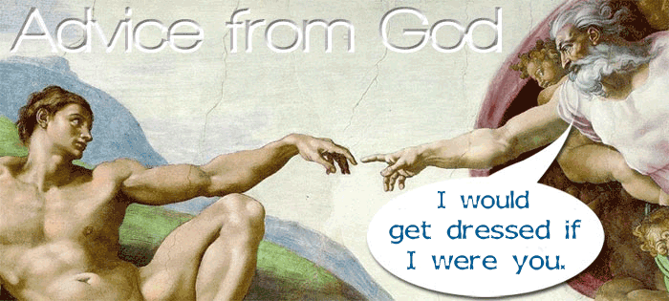
HOW DO YOU GET
YOUR ADAM ON?

Slide 10

SOMETIMES
YOU WANT TO CREATE

Slide 11
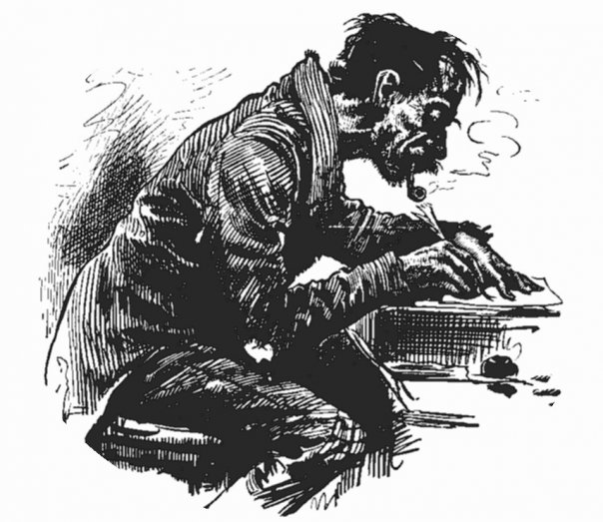
SOMETIMES
YOU WANT TO WRITE

Slide 12

SOMETIMES
YOU WANT TO GO

Slide 13

WELCOME TO A
FLUID WAY OF THINKING

Slide 14
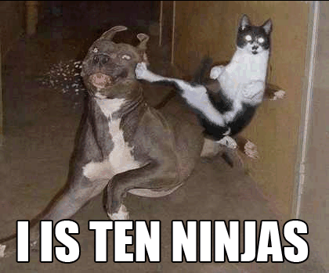
IS THIS GUY STILL
USING LOLCATS? (SRSLY)

Slide 15
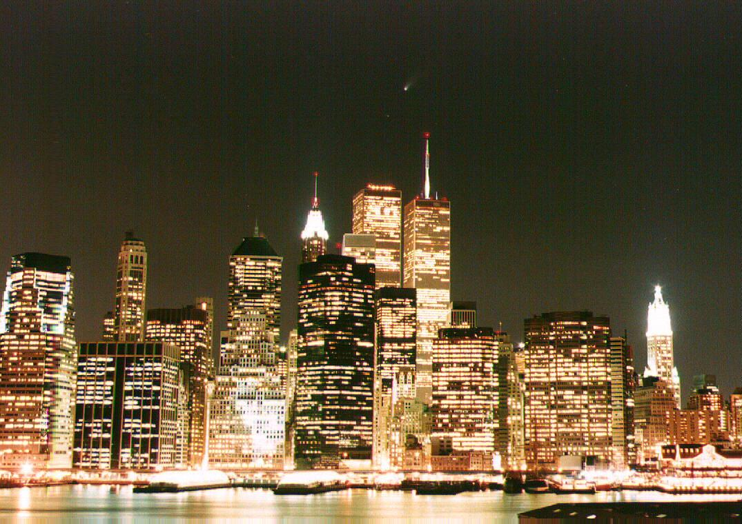
THE CITY SO NICE
THEY NAMED IT TWICE

Slide 16
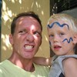
THE MAN, THE MYTH
THE ASYNC SOCKET CALL

Slide 17

BUZZWORDS ARE THE CRUTCH
OF BAD DECK BUILDERS

Slide 18
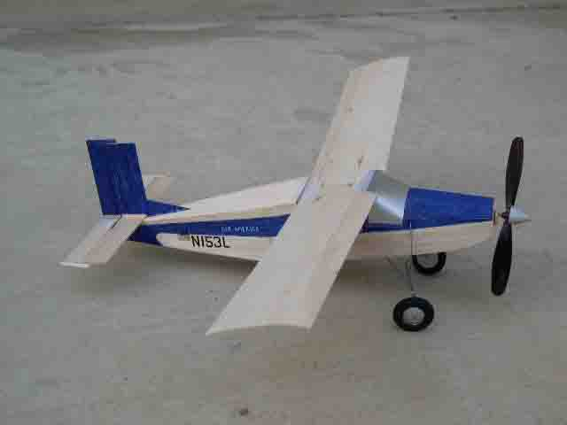
LET'S TALK ABOUT
MODELS

Slide 19
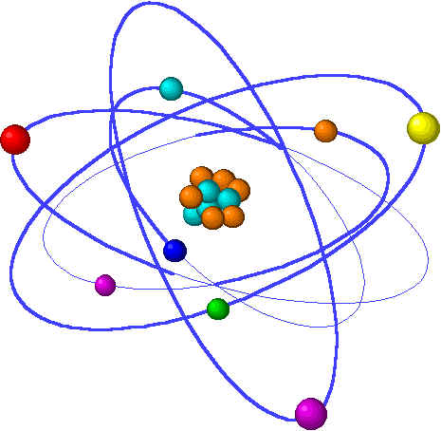
OBJECTS ARE ATOMIC
BOOM

Slide 20
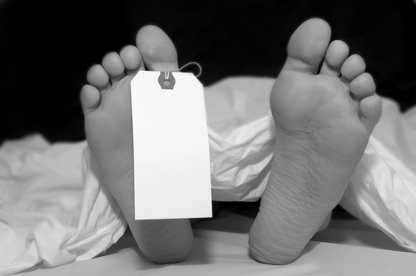
CREEPIEST SLIDE
YOU'LL SEE THIS WEEK

Slide 21
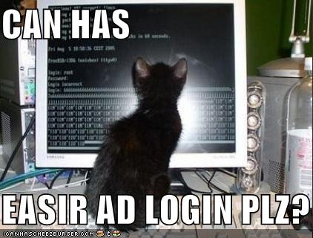
NAMESPACE SEARCHES
DON'T RETURN LOLCATS

Slide 22

IT ALSO HAS
PERMISSIONS

Slide 23

DO YOU
UNDERSTAND?

Slide 24

SCREW THIS HIPPIE NOISE
SHOW ME SOME CODE.

Slide 25
GITHUB.COM/RobSpectre/Talks
@dN0t
#FLUIDINFO
ABOUT.ME
/rob.spectre

Slide 26
THANK
YOU!

Slide 27
QUES TIONS?

